Slide 1


Chun Ming Wu
April 22, 2024

Slide 2

Outline
Executive Summary
Introduction
Methodology
Results
Conclusion
Appendix

Slide 3
Executive Summary
Methodology
Applying Data Science to predict if Falcon 9 first stage will land successfully.
Utilized variety of data science tools to analyze data and solve real-world problem.
Summary of all results
Falcon 9 has highest successful launch at the KSC LC-39A launch site.
The successful launch rate is depending on the location, payload mass and booster version.

Slide 4
Introduction
STORY
Travelling to Space is exciting and expensive. SpaceX is one of the leading company who has been working to build fully reusable Falcon Rocketship since 2006. SpaceY is another company to join the space race.
SpaceX will provide future travel to space at affordable price if the first stage lands successfully. This will greatly reduce the launch cost and making future space travel within reach for future generations to come.
As a data scientist in SpaceY, I have analyzed SpaceX’s launch data and determine the price of each launch.
PROBLEM
How to determine if the first stage will land successfully

Slide 5

Section 1

Slide 6
Methodology
Executive Summary
Data collection methodology:
Use SpaceX REST API to collect launches data, such as Rocket Used, payload delivered, launch specifications, landing specifications, and landing outcome.
Use request library to obtain the launch data, use JSON to normalize data
Use BeautifulSoup package to web scaping data from Wiki pages and converted data to Pandas dataframe
Perform data wrangling
Remove Falcon 1 data, reset flight number,
Replace Null data in PayloadMass column with average PayloadMass value
Perform exploratory data analysis (EDA) using visualization and SQL
Perform interactive visual analytics using Folium and Plotly Dash
Perform predictive analysis using classification models
How to build, tune, evaluate classification models

Slide 7
Data Collection
Request and parse the SpaceX launch data using the GET request
Json_normalize results and convert to Pandas dataframe
Extract rocket data to a dictionary and convert to dataframe
Filter only Falcon 9 data
Data Wrangling missing values

Slide 8
Data Collection – SpaceX API
GitHub link
Request and parse the SpaceX launch data using the GET request response=requests.get(spacex_url)
Json_normalize results and convert to Pandas dataframe: json.loads(rocketjsonfile.text)
pd.DataFrame(results)data = pd.json_normalize(results)
Extract rocket data to a dictionary and convert to dataframe: dfLaunch = pd.DataFrame(launch_dict)

Slide 9
Data Collection - Scraping
GitHub Link
Request the Falcon9 Launch Wiki page from its URL Falcon9Wiki=requests.get(static_url)
Use BeautifulSoup object to parse the result
Falcon9Wiki=requests.get(static_url)
Extract all column/variable names from the HTML table header
html_tables=soup.find_all('table’)
first_launch_table=html_tables[2]
Extract each row into a dictionary and convert to dataframe: forrowsintable.find_all("tr"):… df=pd.DataFrame(all_rows)

Slide 10
Data Wrangling
Use EDA method to find patterns in the data and determine what would be the label for training supervised models. GitHub Link
Calculate the number of launches on each site NumOfLaunchesOfEachSite=df['LaunchSite'].value_counts()
Calculate the number and occurrence of each orbit NumofOccurenceOfOrbit=df['Orbit'].value_counts()
Calculate the number and occurence of mission outcome of the orbits landing_outcomes=df['Outcome'].value_counts()
create a set of outcomes where the second stage did not land successfully fori,outcomeinenumerate(landing_outcomes.keys()):print(i,outcome) bad_outcomes=set(landing_outcomes.keys()[[1,3,5,6,7]])
Create a landing outcome label from Outcome column landing_class=df['Outcome'].to_list()
df['Class']=landing_class

Slide 11
EDA with Data Visualization
I used seaborn library catplot to visualize different features relationships to the landing outcomes. The scatter plot shows the distributions of different variable across different categories, it also shows the outliers and I can compare the distributions between categories as well.
Flightnumber increases, the first stage is more likely to land successfully. There is no relationship between flight number and GTO orbit.
PayloadMass increases, the first stage has less successful landing
Different launch sites have different success rates. CCAFS LC-40, has a success rate of 60 %, while KSC LC-39A and VAFB SLC 4E has a success rate of 77%
Visualize the relationship between success rate of each orbit type and launch site.
Bar Chart
I used bar chart to compare the success landing rate of each orbit type. We found SO has 0 success landing, ES-L1, GEO, HEO, SSO has similar success rate.
Line Graph
The line graph shows the trend of successful landing over the years, since 2023, the successful landing rate kept increasing until 2020
GitHub Link

Slide 12
EDA with SQL
Use limit to show first 5 rows from SPACEXTABLE table
select * from SPACEXTABLE where Launch_Site like '%CCA%' limit 5
Display the total payload mass carried by boosters launched by NASA (CRS)
select sum("PAYLOAD_MASS__KG_") as Total_Payload_mass from SPACEXTABLE where Customer = 'NASA (CRS)’
Display average payload mass carried by booster version F9 v1.1
select avg("PAYLOAD_MASS__KG_") as Average_Payload_Mass from SPACEXTABLE where Booster_Version = 'F9 v1.1’
List the date when the first succesful landing outcome in ground pad was achieved
select min(Date) as Landing_Date from SPACEXTABLE where Landing_Outcome='Success (ground pad)’;
List the names of the boosters which have success in drone ship and have payload mass greater than 4000 but less than 6000
select Booster_Version, PAYLOAD_MASS__KG_ from SPACEXTABLE where Landing_Outcome ='Success (drone ship)' and PAYLOAD_MASS__KG_ between 4000 and 6000;
List the total number of successful and failure mission outcomes
select Mission_OUtcome, count(Mission_Outcome) as NumOfSuccessOrFail from SPACEXTABLE group by Mission_Outcome;
List the names of the booster_versions which have carried the maximum payload mass. Use a subquery
select Booster_Version from ( select Booster_Version, max(PAYLOAD_MASS__KG_) from SPACEXTABLE);
List the records which will display the month names, failure landing_outcomes in drone ship ,booster versions, launch_site for the months in year 2015.
select substr(Date, 6,2) as Month, Landing_Outcome, Booster_Version, Launch_Site from SPACEXTABLE where Landing_Outcome ='Failure (drone ship)' and substr(Date,0,5)='2015’;
Rank the count of landing outcomes (such as Failure (drone ship) or Success (ground pad)) between the date 2010-06-04 and 2017-03-20, in descending order.
select Landing_Outcome, COUNT(Landing_Outcome) as Counter from SPACEXTABLE where Date >= '20100604' and Date <='20170320' group by Landing_Outcome order by COUNT(Landing_Outcome) DESC
GitHub Link

Slide 13
Build an Interactive Map with Folium
I created the following 4 markers, 4 circles for all 4 launch sites. Each circle used add_child(folium.Popup(LaunchSiteName)) to show the Launch site name when it is clicked.
I use marker_cluster to add all of the landing success or fail markers for each launch site. I also use folium.Icon to shows the landing outcome to either Red or Green. Red is for fail landing, Green is for successful landing.
I added a folium.polyline to show the proximity of nearest coastline, railway, highway, and city to one of the landing site.
Adding the markers, circles, and landing outcome status help users to visualize the locations of the launch site along with its historical landing outcomes on the map. The polyline aids user to make decision to choose new launch site location based on the nearby environments. For example, launch site should be picked based on the distance of city for safety reason, it should be farther away from city.
GitHub Link

Slide 14
Build a Dashboard with Plotly Dash
The Plotly Dash has one Pie Chart and one Scatter plot, and one dropdown list box and a ranger slider.
Dropdown list box list 4 launch site locations and All option. The launch site options are the input variable for the call back function.
The range slider represent the PayloadMass weight. User can drag the slider ticker to change the PayloadMass range. PayloadMass is also the input variable for the callback function.
If user chooses All in the Launch Site dropdown list box, the Pie Chart will show success landing rate by all 4 launch sites and show the scatter plot with the selected PayloadMass range.
If user chooses a specific Launch Site, the Pie Chart will show the Success and Fail ratio, the scatter chart will filter by the selected PayloadMass range.
When user drag the range slider, the scatter graph will be updated according to the PyLoadMass range
GitHub Link

Slide 15
Predictive Analysis (Classification)
Converted the Class column to NumPy array. Standardized the data in X and transform it to ndarray type. Split the data into 80% training data, 20% testing data. Use LogisticRegression to fit the training data, tuned the data using cross validation to find the best parameters, calculate the accuracy rate, then use Confusion Matrix to check how accurate the predication against the actual outcome. Repeat the same steps to train the model using SVM, DecisionTree , K nearest neighbors, then compare the accuracy.
GitHub Link
Step 1: Standardize and Transform the data
Y = data['Class'].to_numpy() scaler = preprocessing.StandardScaler().fit(X) X = scaler.transform(X)
Step 2: Split the date:
X_train, X_test, Y_train, Y_test = train_test_split( X, Y, test_size=0.2, random_state=2)
Step 3: Training the Model
lr=LogisticRegression() logreg_cv = GridSearchCV(lr, parameters,cv=10) logreg_cv.fit(X_train, Y_train)
Step 4: Evaluate the Model
logreg_accuracy = logreg_cv.score(X_test, Y_test)
Step 5: Go back to Step 1 Repeat first step and continue to use different classification methods and parameters to train and test and compare the accuracy. Stop when you find the best classification method.

Slide 16
Results
Exploratory data analysis results The exploratory data analysis results indicate that first stage landing success rate increases since 2013 until 2020. Orbit type SO has no successful landing, while ES-L1, GEO, HEO and SSO has equal number of successful landing. As the FlightNumber increases, the success rate increases. CCAFS LC-40, has a success rate of 60 %, while KSC LC-39A and VAFB SLC 4E has a success rate of 77%.

Slide 17

Section 2

Slide 18
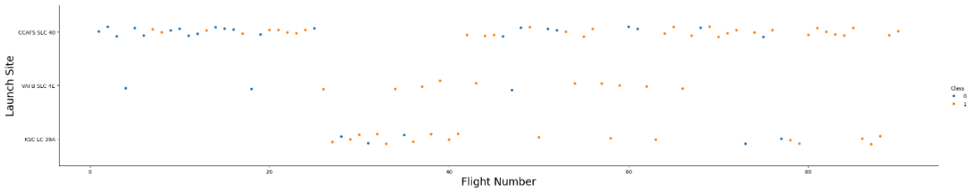
Flight Number vs. Launch Site
Scatter plot of Flight Number vs. Launch Site ('CCAFS SLC 40' 'VAFB SLC 4E' 'KSC LC 39A’)
CCAFS LC-40 has more fails landing between flight number 0 – 20, more success on filight number > 80
VAFB SLC 4E has 2 success landings between 0-20 flight number, and has more failed landing for flight number > 20
KSC LC 39A has more successful landing between flight number 20 – 60, in general it has more successful landing than fail landing
Show the screenshot of the scatter plot with explanations

Slide 19
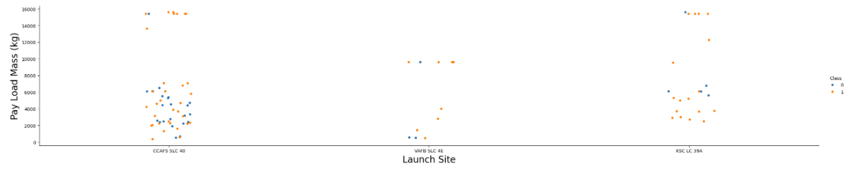
Payload vs. Launch Site
Scatter plot of Payload vs. Launch Site
CCAFS SLC 40 - has more successful landing in PayloadMass range 14000-16000 kg, and similar success and fail rate between 0 – 8000kg
VAFB SLC 4E - has more successful landings in PayloadMass range 0 – 4000 kg, and more successful landing at 10000 payloadmass, however compare to other launch site, this site seems have a higher number of successful landing rate, number cannot tell the true pictures as this site may have less number of launches in general.
KSC LC 39A – it has more successful landing in PayloadMass range 0 – 8000 kg and 14000 – 16000 kg, in general this site has pretty good successful landing rate.

Slide 20
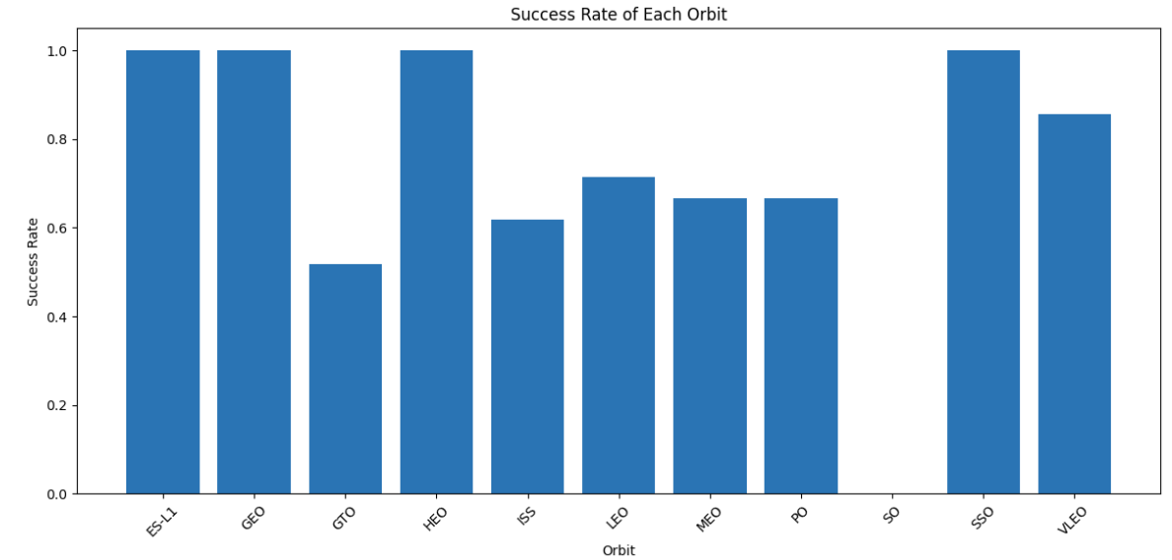
Success Rate vs. Orbit Type
A bar chart for the success rate of each orbit type
SO has not successful landing
ES-L1, GEO, HEO, SS0 has equal chance of successful landing rate, these orbit types have the highest successful landing rate comparing to the other orbit type.
MEO and PO has same successs rate as well

Slide 21
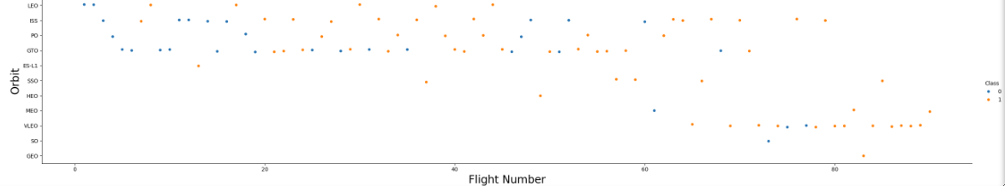
Flight Number vs. Orbit Type
Scatter point of Flight number vs. Orbit type
Orbits: 'LEO' 'ISS' 'PO' 'GTO' 'ES-L1' 'SSO' 'HEO' 'MEO' 'VLEO' 'SO' 'GEO'
You should see that in the LEO orbit the Success appears related to the number of flights; on the other hand, there seems to be no relationship between flight number when in GTO orbit.

Slide 22
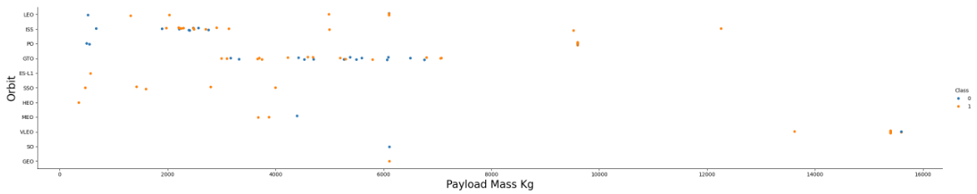
Payload vs. Orbit Type
Show a scatter point of payload vs. orbit type
With heavy payloads the successful landing or positive landing rate are more for Polar, LEO and ISS.
However for GTO we cannot distinguish this well as both positive landing rate and negative landing(unsuccessful mission) are both there here.

Slide 23
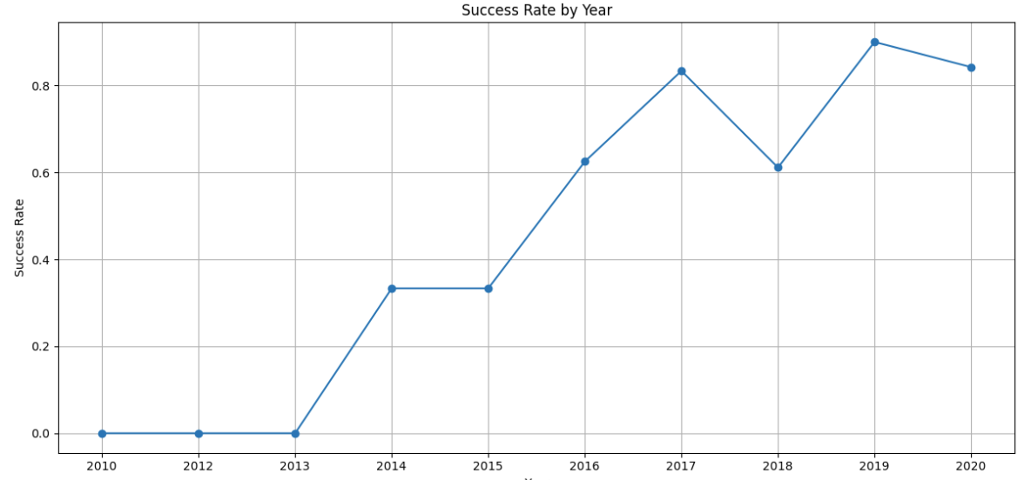
Launch Success Yearly Trend
A line chart of yearly average success rate
You can observe that the success rate since 2013 kept increasing till 2020

Slide 24
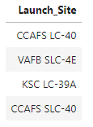
All Launch Site Names
Find the names of the unique launch sites
Query: %sql select distinct(Launch_Site) from SPACEXTABLE;
Use distinct() function to filter the unique launch site name.

Slide 25
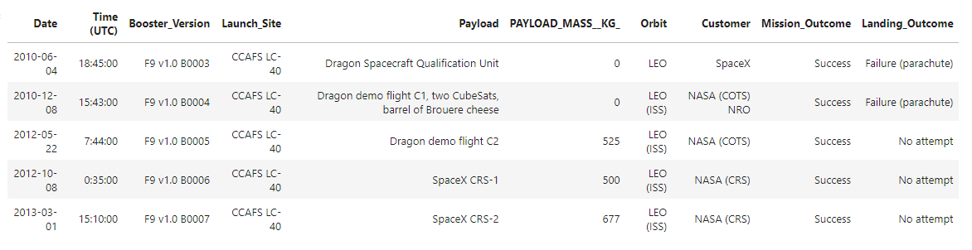
Launch Site Names Begin with 'CCA'
Find 5 records where launch sites begin with `CCA`
%sql select * from SPACEXTABLE where Launch_Site like 'CCA%' limit 5 use wildcard to filter Lauch_Site name that has CCA in it and only return the 5 rows

Slide 26
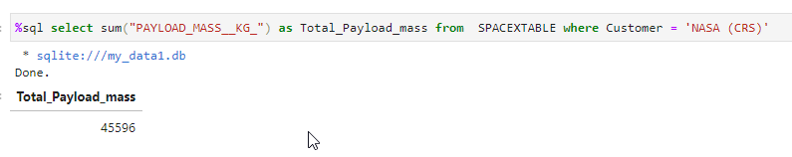
Total Payload Mass
Calculate the total payload carried by boosters from NASA
%sql select sum("PAYLOAD_MASS__KG_") as Total_Payload_mass from SPACEXTABLE where Customer = 'NASA (CRS)’
Use sum() to return the total Payload Mass of NASA customer

Slide 27
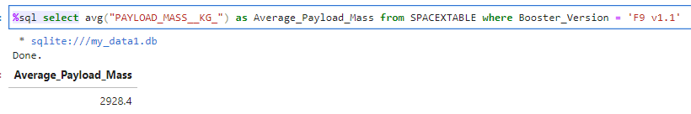
Average Payload Mass by F9 v1.1
Calculate the average payload mass carried by booster version F9 v1.1
%sql select avg("PAYLOAD_MASS__KG_") as Average_Payload_Mass from SPACEXTABLE where Booster_Version = 'F9 v1.1’
Use avg(columnname) function to calculate the average Payload Mass of Booster version is F9 v1.1

Slide 28
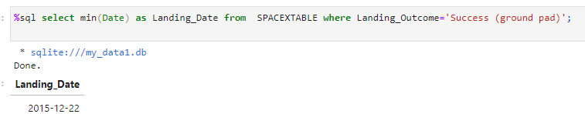
First Successful Ground Landing Date
Find the dates of the first successful landing outcome on ground pad
%sql select min(Date) as Landing_Date from SPACEXTABLE where Landing_Outcome='Success (ground pad)’;
Use min() function to return the earliest date

Slide 29
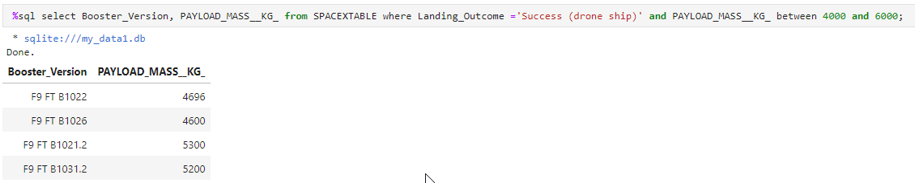
Successful Drone Ship Landing with Payload between 4000 and 6000
List the names of boosters which have successfully landed on drone ship and had payload mass greater than 4000 but less than 6000
%sql select Booster_Version, PAYLOAD_MASS__KG_ from SPACEXTABLE where Landing_Outcome ='Success (drone ship)' and PAYLOAD_MASS__KG_ between 4000 and 6000;
Use between to filter the Payload Mass range

Slide 30
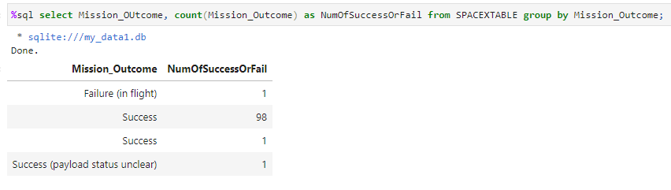
Total Number of Successful and Failure Mission Outcomes
Calculate the total number of successful and failure mission outcomes
%sql select Mission_OUtcome, count(Mission_Outcome) as NumOfSuccessOrFail from SPACEXTABLE group by Mission_Outcome;
Use count() function calculate the total number of successful and fail landing, group the result by Mission Outcome

Slide 31
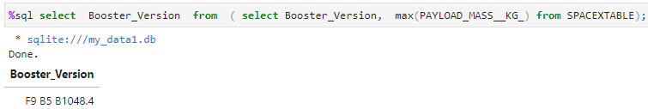
Boosters Carried Maximum Payload
List the names of the booster which have carried the maximum payload mass
%sql select Booster_Version from ( select Booster_Version, max(PAYLOAD_MASS__KG_) from SPACEXTABLE);
Use Max function to reutn the maximum PayLoad mass

Slide 32
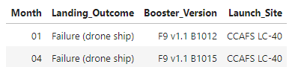
2015 Launch Records
List the failed landing_outcomes in drone ship, their booster versions, and launch site names for in year 2015
%sql select substr(Date, 6,2) as Month, Landing_Outcome, Booster_Version, Launch_Site from SPACEXTABLE where Landing_Outcome ='Failure (drone ship)' and substr(Date,0,5)='2015’;
Use substr to get the part of month and year, and filter by year

Slide 33
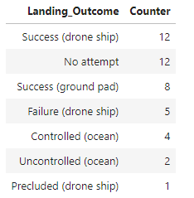
Rank Landing Outcomes Between 2010-06-04 and 2017-03-20
Rank the count of landing outcomes (such as Failure (drone ship) or Success (ground pad)) between the date 2010-06-04 and 2017-03-20, in descending order
%sql select Landing_Outcome, COUNT(Landing_Outcome) as Counter from SPACEXTABLE where Date >= '20100604' and Date <='20170320' group by Landing_Outcome order by COUNT(Landing_Outcome) DESC
Use count to count the total number of landing, and group by the outcome and filter by date

Slide 34

Section 3

Slide 35
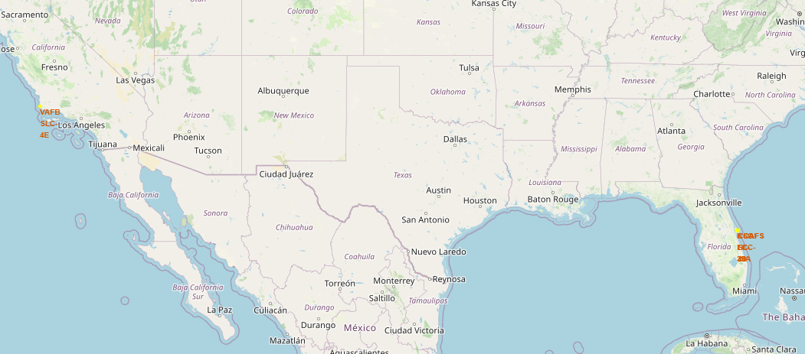
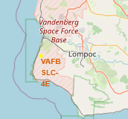
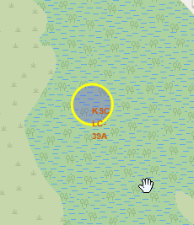
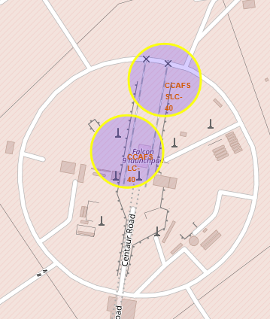
Launch Sites Locations Map
CCAFS LC-40 , CCAFS SLC-40, VAFB SLC-4E are located near the coastline, this location is convenient to plan landing pad to land in ocean pad
KSC LC-39A – is located in remote isolated forest far away from the city, is ideal landing zone to land on the land instead of water
KSC LC – 39A
VAFB SLC-4E
CCAFS SLC 40
CCAFS LC-40

Slide 36
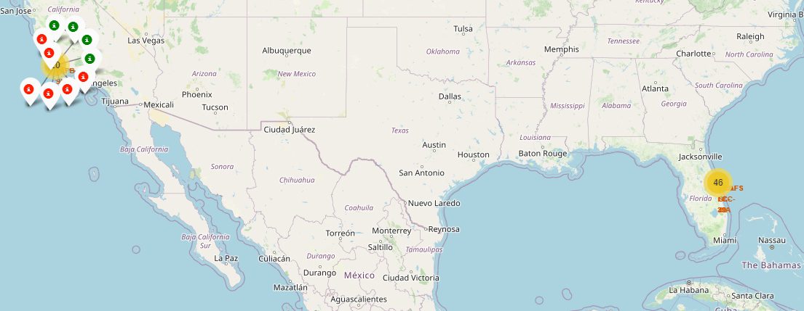
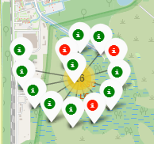
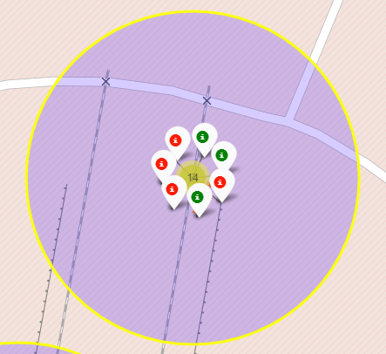
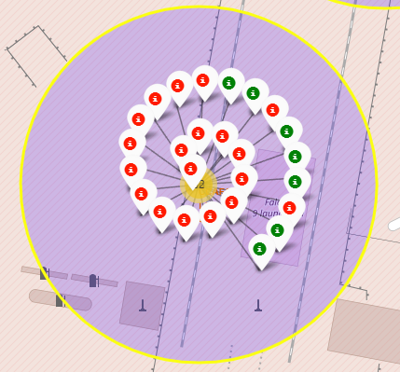
Launch Site Map with Successful or Fail Landing Count
KSC LC – 39A
This map clearly shows that the KSC LC – 39A has relatively high success rates , and CCAFS LC-40 has higher failure rate.
VAFB SLC-4E
CCAFS SLC 40
CCAFS LC-40

Slide 37
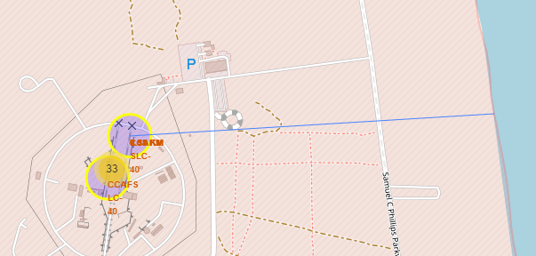
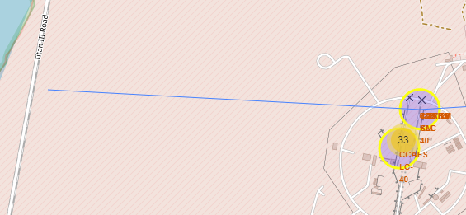
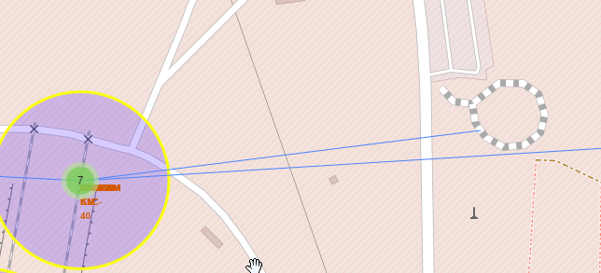
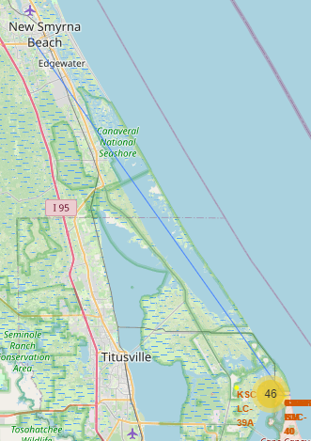
Proximities Map for Launch Site CCAFS SLC-40 to the nearest coastline, railway, highway, city
Selected launch site to its proximities such as railway, highway, coastline, with distance calculated and displayed
As you see the blue lines indicate the distance from the launch site CCAFS SLC-4 to the nearest coastline, highway, railway, and city.
coastline
highway
railway
city

Slide 38

Section 4

Slide 39
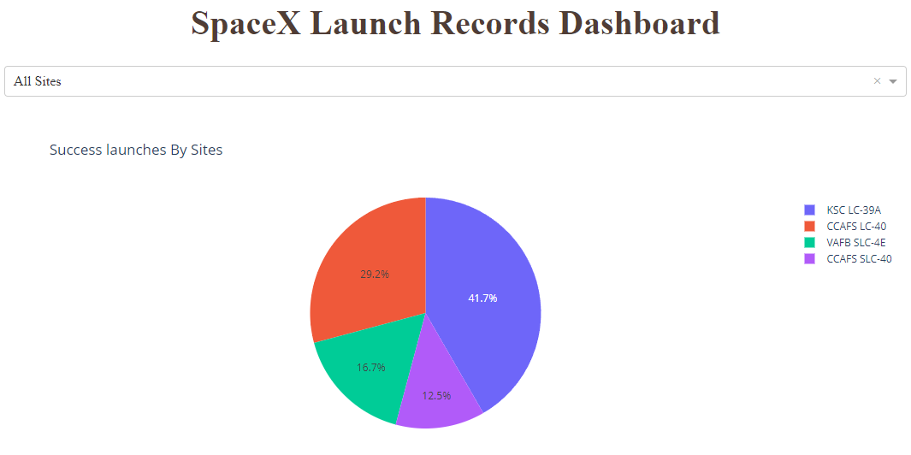
Dashboard – Launch Success Count for all sites
As you see from this pie graph, KSC LC-39A has the highest success rate , follow by CCAFS LC-40 launch Site.

Slide 40
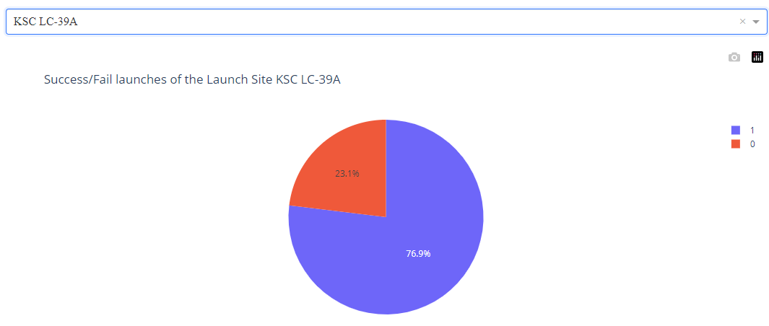
Launch site has the highest success ratio of landing
As you see the launch site KSC LC-39A has the highest success ratio 76.9%.

Slide 41
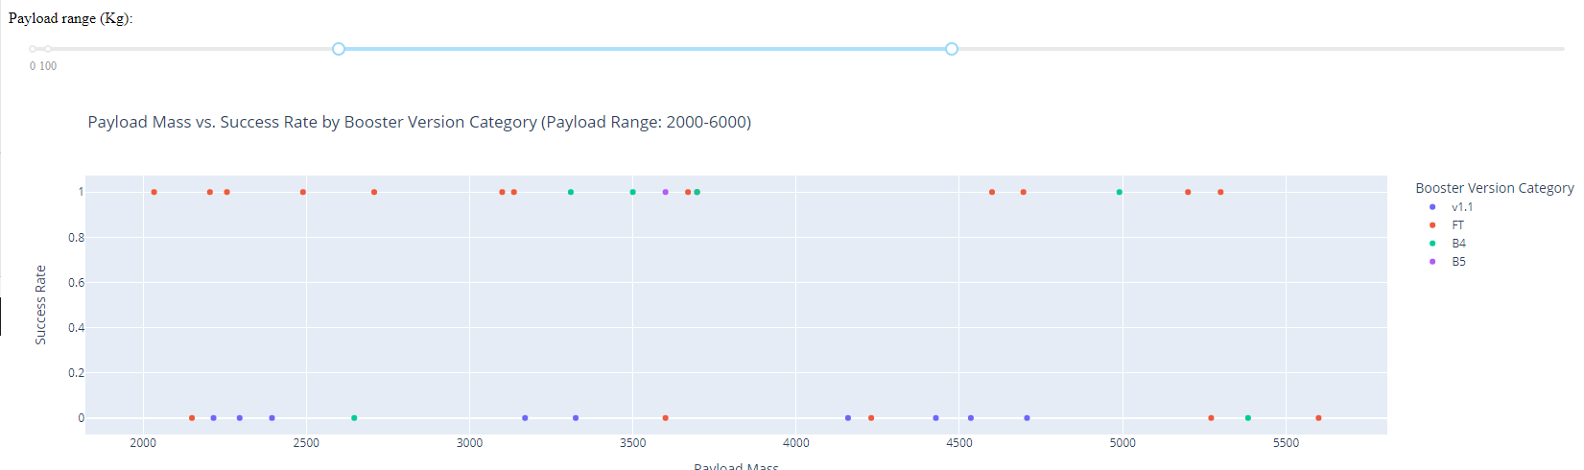
Launch Success by Payload Mass Range and Booster Version
As you see between 2000 – 6000, booster version FT has highest success rate, as the payload masss increase, the success rate decrease for most of the booster except B4

Slide 42

Section 5

Slide 43
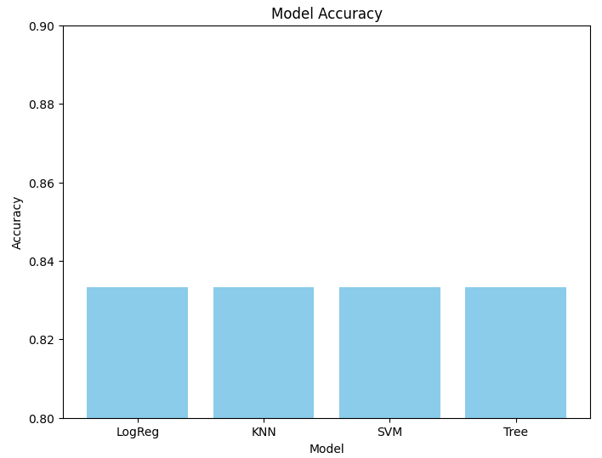
Classification Model Accuracy Comparison
The bar graph shows that 4 model all have same accuracy rate.

Slide 44
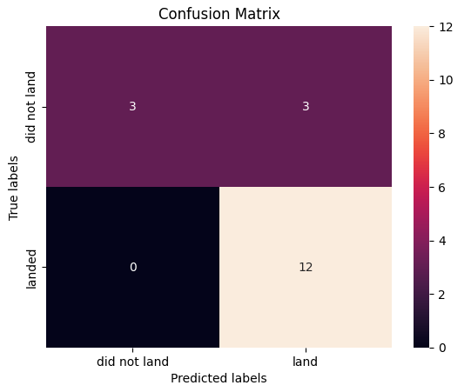
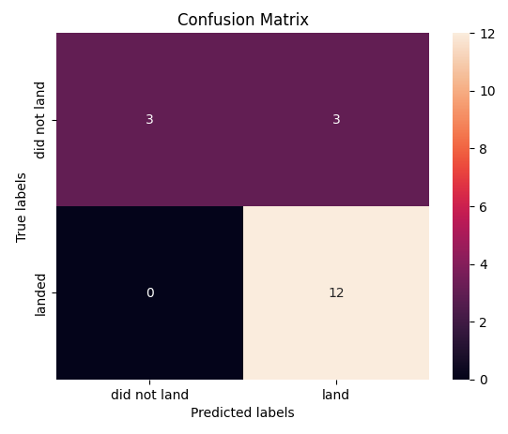
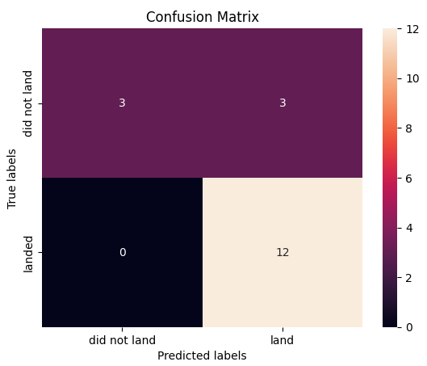
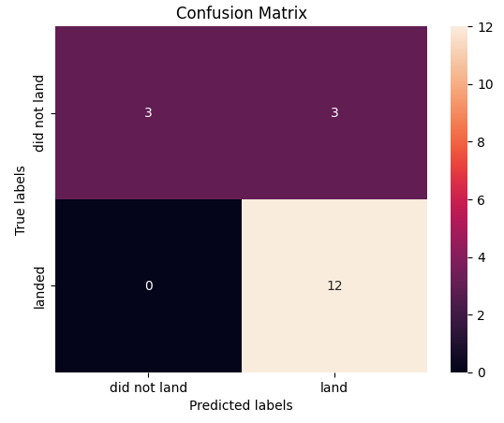
Classification Model Accuracy By Confusion Matrix
LogReg | SVM
Tree | KNN
All confusion Matrixs show all classification models have some outcomes.

Slide 45
Conclusions
Defined the problem is how to predict the successful first stage launching rate based on the collecting data from SpaceX API.
Applied are SpaceX API, webscraping to collect the data, then we clean and preprocessing the data.
Exploratory Data Analysis: explore the data to gain insights, identify patterns and understand the relationships between variables. For example, how does the payload mass, orbit, launch site affect the outcome of the launch.
Used feature selection/engineering to label for the class column which is then used in the Launch site map to show the success/fail count of the past launches of each launch site.
Utilized Logistic Regress, Decision Tree, SVM, KNN classification models to train the splited data. I found all classification models has the same accuracy.
The next step is to train the model into production, making it accessible for use in real world for SpaceY company.

Slide 46


